Slide 1
Information Visualization Visualization Sketch
83463 – Francisco Campaniço
83482 – João Rafael
83558 – Rodrigo Oliveira
G13-A

Slide 2
Overview
01

Slide 3
Overview
Choropleth Map:
Scatter plot;
Bar chart;
Dynamic Heat Map:
Bar chart;

Slide 4
Visual encoding
02

Slide 5
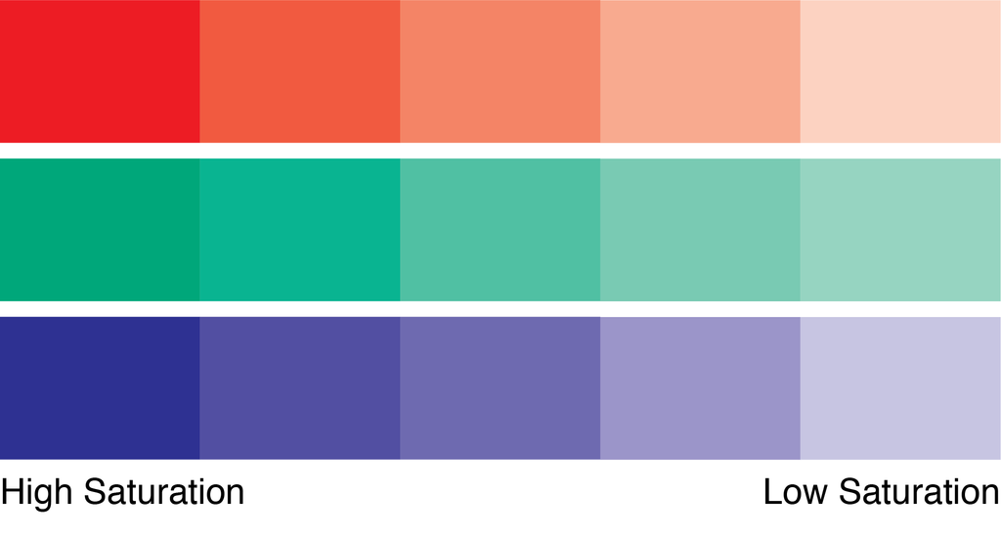
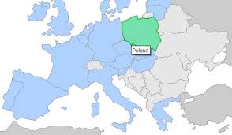
Visual Encoding
Choropleth Map:

Slide 6
Visual Encoding
Scatter plot:
% Unemplyoment
% Urban population
GDP (USD)

Slide 7
Visual Encoding
Bar chart:
Height indicates earnings or quantity of tournaments

Slide 8
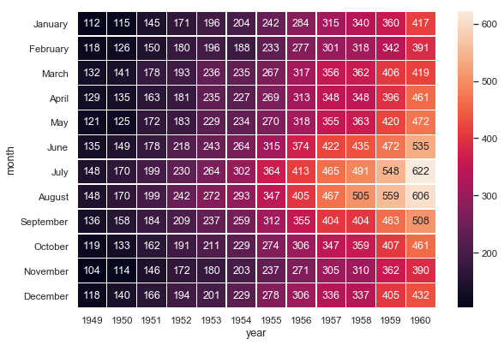
Visual Encoding
Dynamic Heat Map:

Slide 9
IDIOM – tasks/questions mapping
03

Slide 10
Task 1
Selected Idiom and why it allows answering each question

Slide 11
Task 2
Selected Idiom and why it allows answering each question

